Slide 1
Probability density estimation

Slide 2
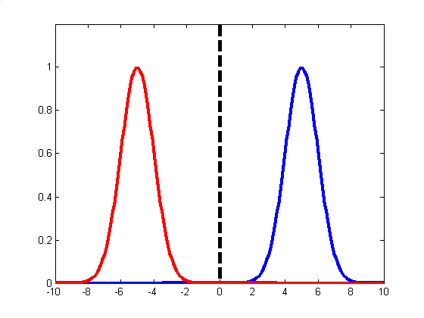
Why? If we can estimate p(x) we can estimate the class conditional probabilities P(x, | C_{i}) and so work out optimal (Bayesian) decision boundary

Slide 3
There are 3 styles of probability density estimation:
Parametric: Assume a specific functional form for the densities. Parameters of the distribution optimised to fit the data. Good if model fits the data bad if not.
Non-parametric: No assumptions about form of the density function, determined entirely from the data. Number of parameters grows with size of the data-set and so models can quickly become unwieldy and can take long to incorporate new data
Semi-parametric: Mixture models. Tries to achieve best of both worlds by allowing general functional form for densities where number of parameters (and thus flexibility of function) can be extended independently of the size of data-set. Could combine worst of both approaches?

Slide 4
Parametric Density Estimation
EG Common assumption that densities are Gaussian (Normal). For 1D data x from a data set X:
Parameters (θ) are: mean E(X) = μ , variance E ( X- μ)² = σ² and must be estimated from data
Maximum Likelihood: maximise the probability of our choice of parameters given data P(θ |X)
Bayesian Inference: parameters described by a probability distribution. Initially set to prior distribution and converted to posterior P(θ |X) thru Bayes theorem once data is observed

Slide 5
For multiple (n) dimensional data x
x feature vector, μ mean vector, covariance matrix Σ an nxn
symmetric matrix where:
σ_{ij} = E [ (X_{i}- μ _{i}) (X_{j}- μ _{j}) ]
ie the correlation between X_{i} and X_{j}
| Σ | = determinant of Σ Σ⁻¹ = inverse of Σ

Slide 6
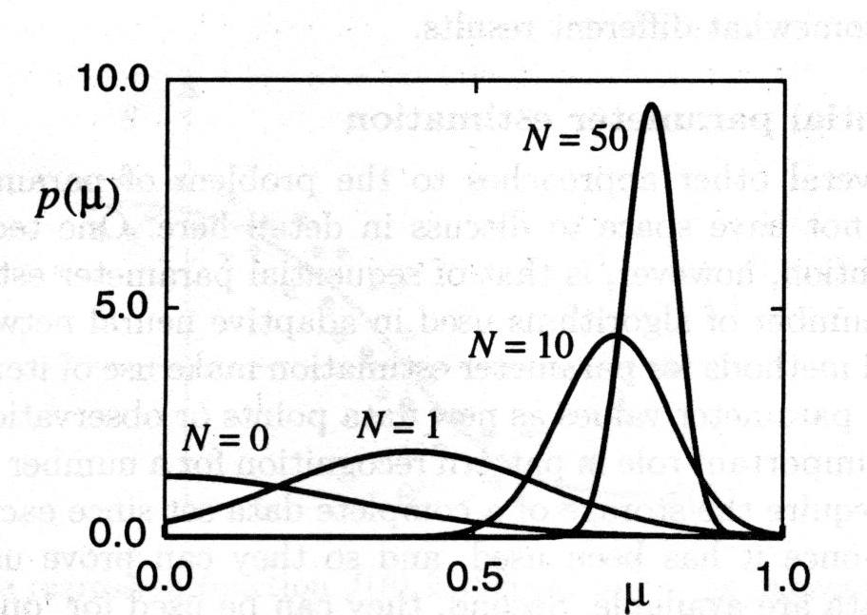
Maximum Likelihood: various iterative algorithms, but if data is gaussian can set:
μ = sample mean; Covariance Σ = sample covariance
where sample is points in data set from respective class (supervised. For unsupervised see eg k-means later)
Bayesian Inference: refine pdf of parameters as more data is received eg from initial values μ₀, σ₀ to μ_{N}, σ_{N}:
Methods equivalent for large N but can differ if N low

Slide 7
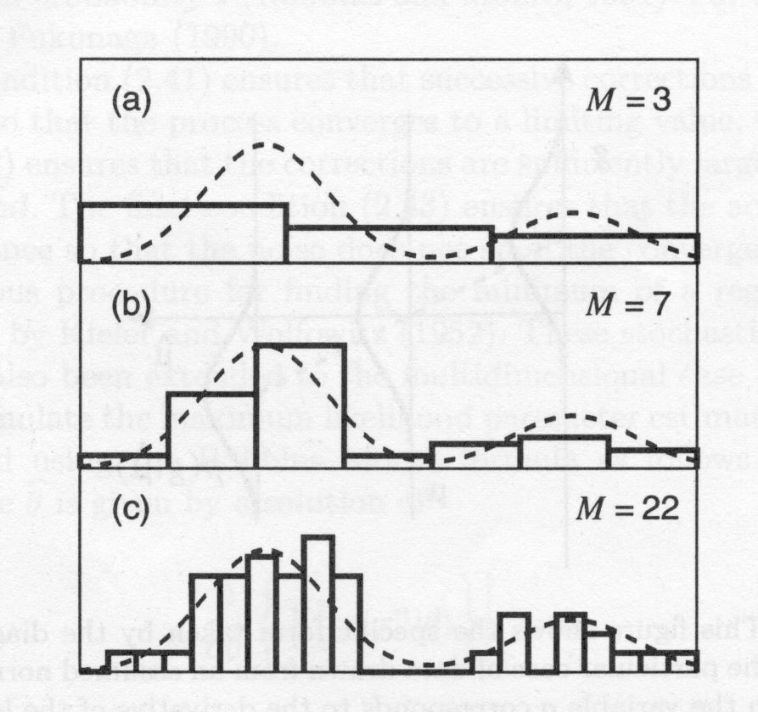
Non-Parametric Density Estimation
EG Divide data into histograms then estimate continuous function. Need to decide how many bins: smoothing parameter, can be problematic to decide on it
Histogram method suffers from curse of dimensionality so need better approaches. Also discontinuous pdf
Form of Clustering: patterns of a class should be grouped or clustered together in feature space. Objects near together must be similar, objects far apart must be dissimilar

Slide 8
For more complex methods return to definition of probability:
for large N, P can be approxed by: P = k/N where k is number of points in R
Therefore assuming R small enough that p(x) is constant get:
P = p V =k/N where V is volume of R so p = k/(NV)
So have 2 methods:
fix V and determine k from data (kernel density estimation)
fix k and determine V from data (k-nearest neighbours)
NB notice the tension between simplifying assumptions: want large N so P=k/N but small R so p (x) is constant. Analagous to choice of smoothing parameter and will be problem specific

Slide 9
Kernel Density Estimation
For a given point x imagine a hypercube centred on x of side h. Suppose number of points falling inside cube is K then define a kernel function H(u) (also known as a Parzen window) by:
H(u) = 1 if |u_{j}|< 1/2 in hypercube, 0 else
Therefore:
K = Σ H((x - x^{i})/h)
and so can estimate density p(x) by:
p(x) = (K/N) (1/h)^{d}
where d is the dimension of the data.
OK but again pdf is discontinuous. Also will suffer from Curse of Dimensionality

Slide 10
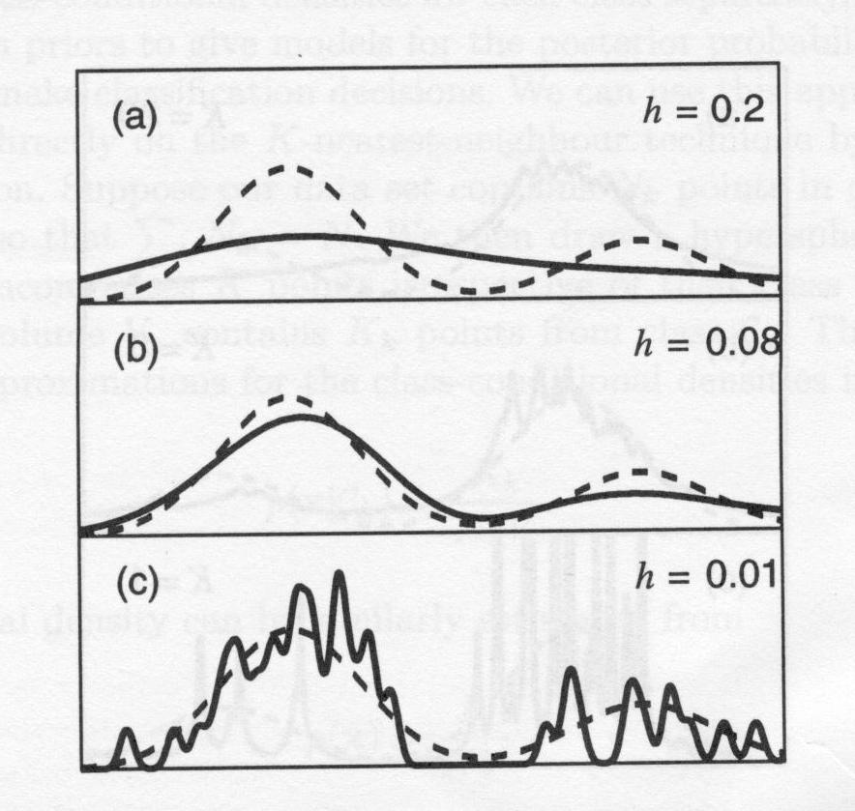
Can use different forms of kernel (eg Gaussian) to get smoother continuous estimates for x.
h again critical: too small => spiky pdf, too big => oversmoothed

Slide 11
K-Nearest Neighbours
One problem with the above is that h is fixed: thus if density of points in space is heterogeneous, some bits are oversmoothed, some bits are under-represented
Therefore, fix K and let h vary: K-Nearest Neighbours
Take a small hypersphere centred on x and allow it to grow till it contains K points. Then estimate density from:
p(x) = K/NV where V is volume of sphere
(NB not a true pdf as integral over all x-space diverges)

Slide 12
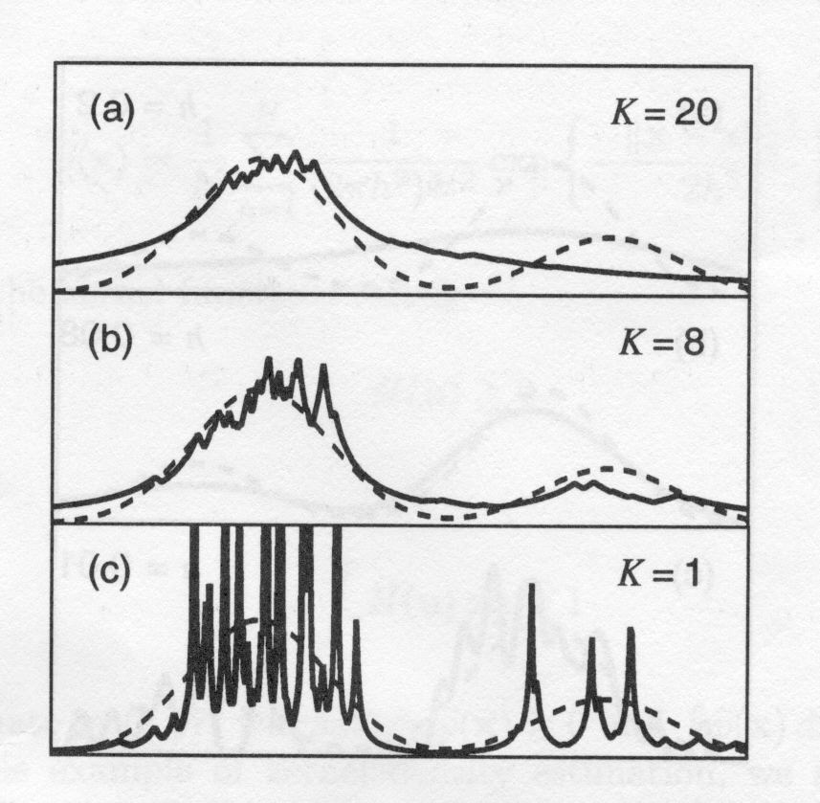
Again K acts as a smoothing parameter. Also, note that for low k this works better for sparse data than having fixed h

Slide 13
K Nearest neigbours Classification
This leads to the K Nearest neighbours classification algorithm. Draw hypersphere around x encompassing K points. Denote number in C_{k} by K_{k} and total number of points in C_{k} by N_{k}. From earlier we have:
p(x) = K /(NV) and p(x|C_{k}) = K_{k} /(N_{k}V)
While priors: P(C_{k}) = N_{k}/N
So by Bayes: P(C_{k} | x) = p(x|C_{k}) P(C_{k}) / p(x) = K_{k} / K
As K is fixed this gives the rule:
Draw hypersphere around x encompassing K points. Assign x to class with most points in sphere

Slide 14
1-Nearest Neighbor Classifier
Special case for k =1: use only the nearest training point:
y is a new feature vector whose class label is unknown
Find the closest training vector to y: x^{i} say
Classify y with the same label as x^{i}
If “closeness determined by Euclidean distance this produces a “Voronoi tesselation” of the space
each point “claims” a cell surrounding it
cell boundaries are polygons

Slide 15
Geometric Interpretation of Nearest Neighbor
1
2
Feature 2
1
2
2
1
Feature 1

Slide 16
Regions for Nearest Neighbors
Each data point defines a “cell” of space that is closest to it. All points within that cell are assigned that class
1
2
Feature 2
1
2
2
1
Feature 1

Slide 17
Decision Boundary
Overall decision boundary = union of cell boundaries where class decision is different on each side
1
2
Feature 2
1
2
2
1
Feature 1

Slide 18
How should the new point be classified?
1
2
Feature 2
1
2
?
2
1
Feature 1

Slide 19
Boundary? Points that are equidistant between points of class 1 and 2
Note: locally the boundary is
(1) linear (because of Euclidean distance)
(2) halfway between the 2 class points
(3) at right angles to connector
1
2
Feature 2
1
2
?
2
1
Feature 1

Slide 20
Finding the Decision Boundaries
1
2
Feature 2
1
2
?
2
1
Feature 1

Slide 21
Finding the Decision Boundaries
1
2
Feature 2
1
2
?
2
1
Feature 1

Slide 22
Finding the Decision Boundaries
1
2
Feature 2
1
2
?
2
1
Feature 1

Slide 23
Decision Region
for Class 1
Decision Region
for Class 2
1
2
Feature 2
1
2
?
2
1
Feature 1

Slide 24
More points means More Complex Decision Boundary
In general: Nearest-neighbor classifier produces piecewise linear decision boundaries
1
Feature 2
1
1
2
2
1
1
2
2
1
1
2
1
2
2
2
Feature 1

Slide 25
Easy and quick “training”: look up distances
Again k is smoothing parameter
As N increases, the optimal k value tends to increase in proportion to log N
In effect, the classifier uses the nearest k feature vectors to “vote” on the class label for a new point y
for two-class problems, if we choose k to be odd (i.e., k=1, 3, 5,…) then there will never be any “ties”
Extensions:
weighted distances (if some of the features are more important/irrelevant => Prior knowledge)
fast search techniques (indexing) to find k-nearest neighbors in d-space

Slide 26
Semi-Parametric Density Estimation/Mixture Models
Here we use a model which is not restricted to a specific functional form but where size of the model does not grow with the size of the data set
Eg: rather than fitting a gaussian kernel to every data fit only to a subset of data points
Price we pay is that setting up the model is labour intensive
Will see an example of this in the k-means algorithm used to generate radial basis functions

Slide 27
Role of smoothing parameter
In all the above have seen that the role of the smoothing parameter is critical
Analagous to the problem of choosing model complexity and is another instance of the bias-variance trade-off
If model over-smoothed it bias becomes large as it ignores the data
Insufficient smoothing leads to high variance and model density is noisy as it responds to individual data points

